Slide 1
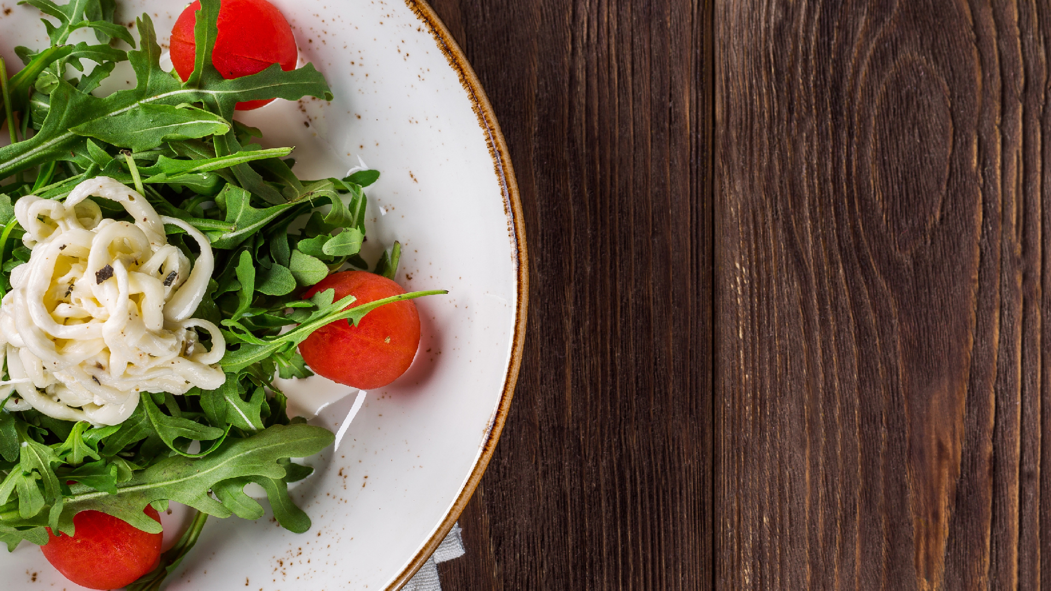
T A S T E T H E B E S T , I T S O N T I M E
Food Delivery Application
S A R V E S H K A U S H I K , M R U G A N D H Z O D A P E

Slide 2
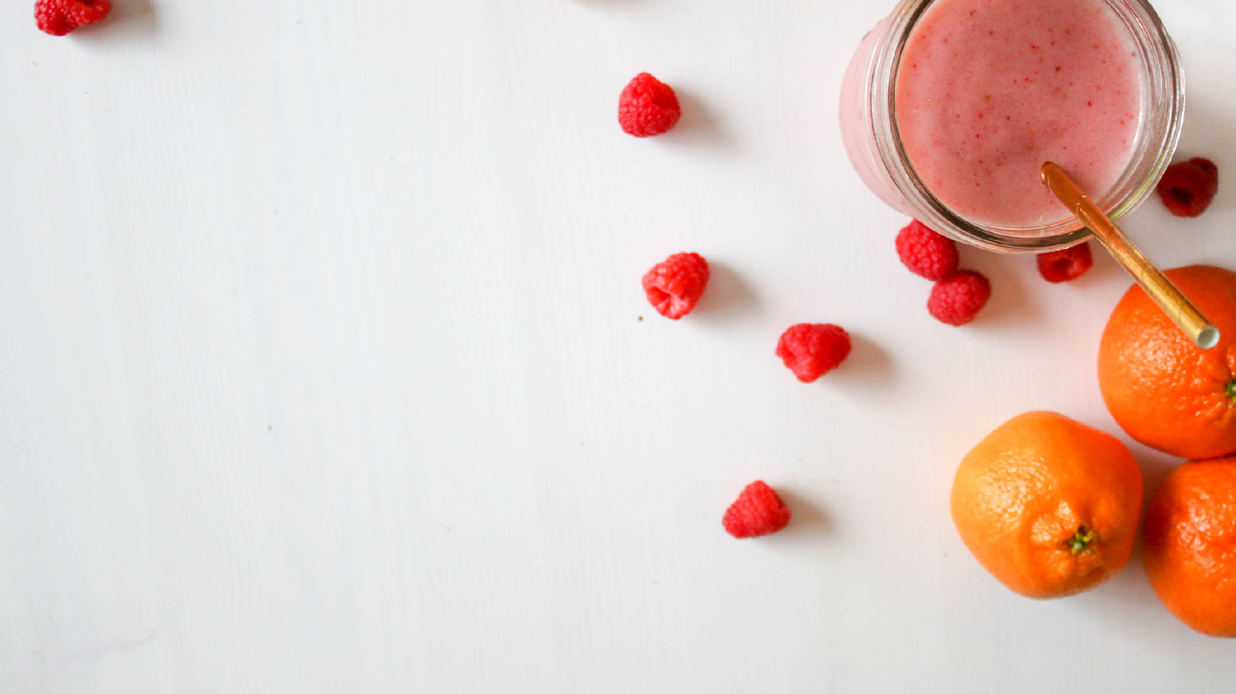
Our Idea
Application that provides robust online food order delivery service.
Users should be able to Order their favorite meal online.
Understand new food trends in their community.
Pick one of the favorite restaurants of their choice.
Users should be able to order food from comfort of their home or they can also perform quick pickup if they are close to restaurant

Slide 3
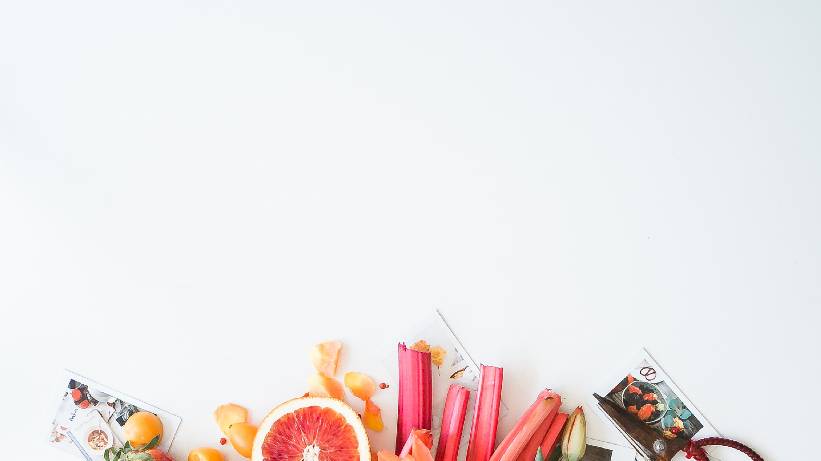
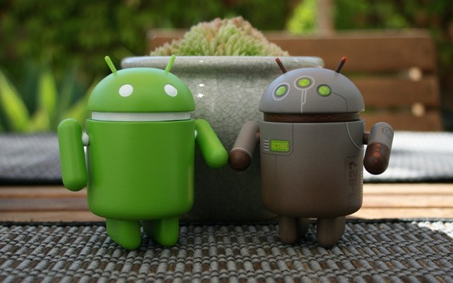

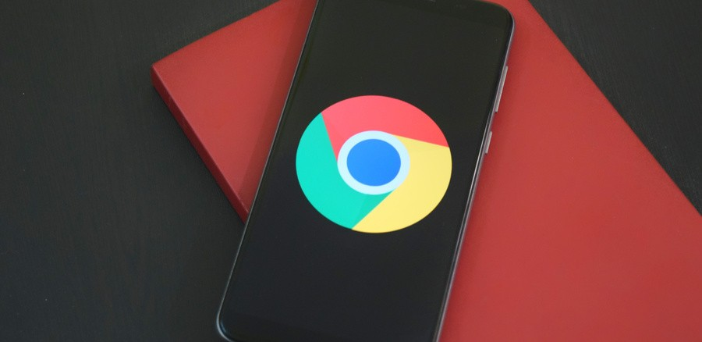



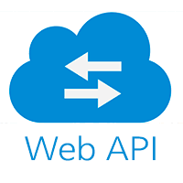
What we are using
The application is android specific, We are using android studio to build our application.
In order to keep data secure and allow user authentication, we are using firebase authentication API
We have also additional functionality where user can sign in to application using third party authentication services such as Google Sign in(Google API).
We implemented firebase cloud messaging to keep our users informed about new food trends and crucial app updates.

Slide 4
What we are using
With the Firebase Realtime Database, we are also using SQL to store valuable user data.
In order to keep data secure and allow user authentication, we are using firebase authentication API.

Slide 5
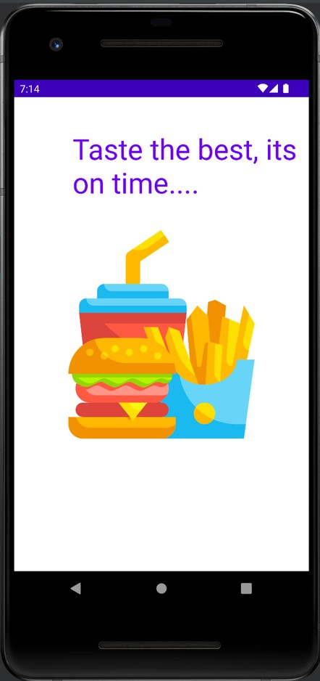
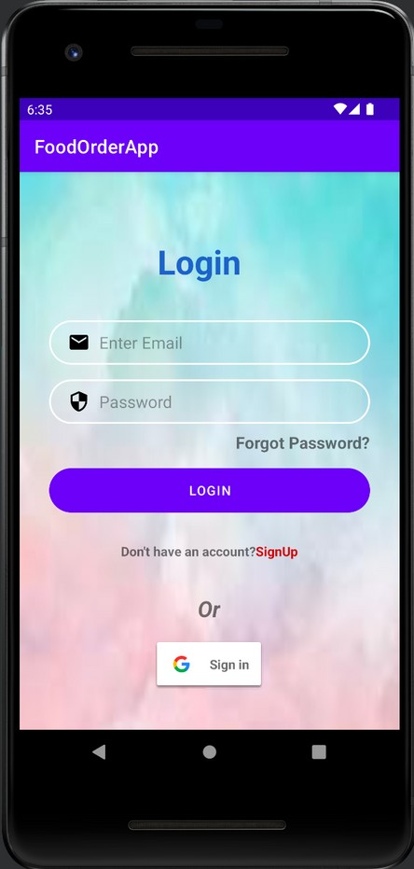

Application Flow
When its time for user to order their favorite meals they will log in to the application.

Slide 6
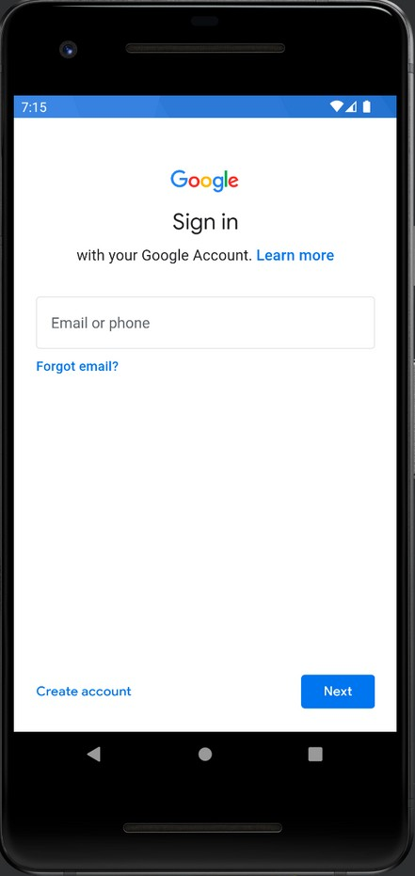

Application Flow
When its time for user to order their favorite meals they will log in to the application using google sign in

Slide 7
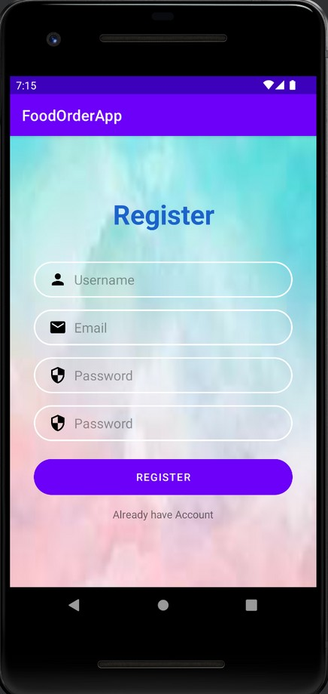

Application Flow
If not registered, User can Sign Up using In-App Signup Feature.

Slide 8
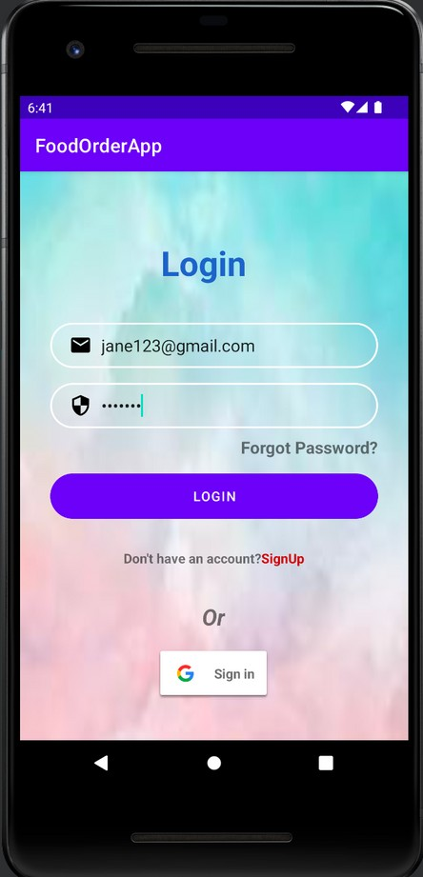
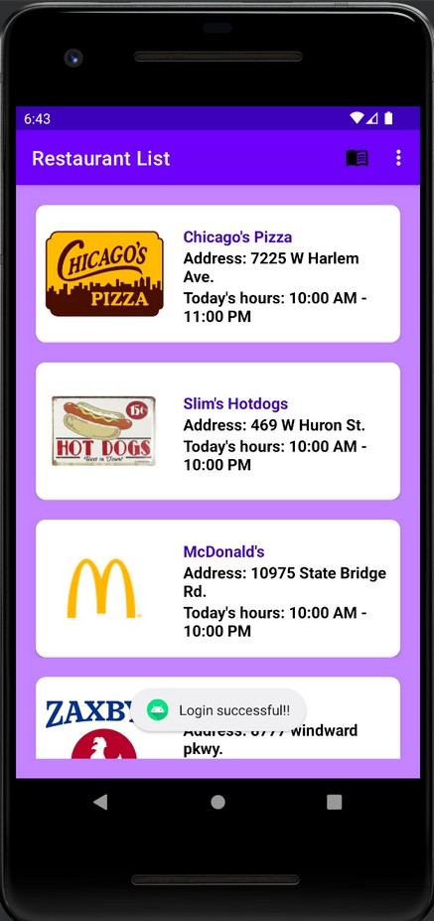

Application Flow
User will have to authenticate with their credentials. Once done they can see list of nearby restaurants.

Slide 9
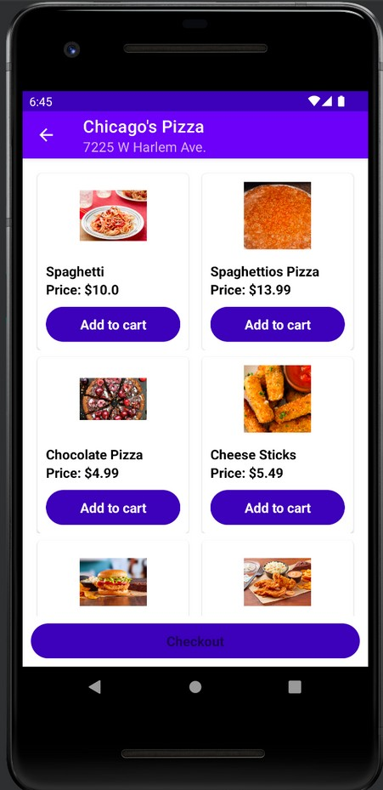
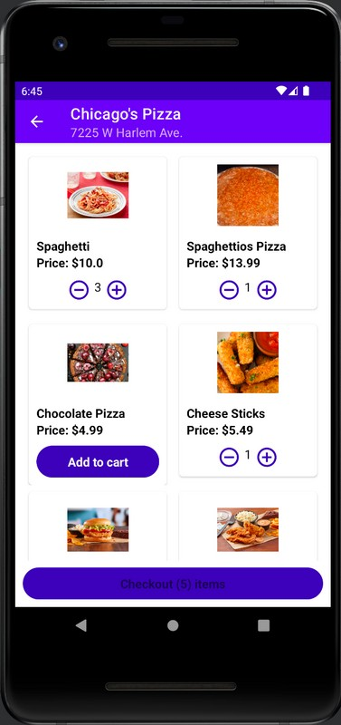

Application Flow
Users will select their favorite dishes and add it to the cart. Once selection is done they will redirected to Check out page.

Slide 10
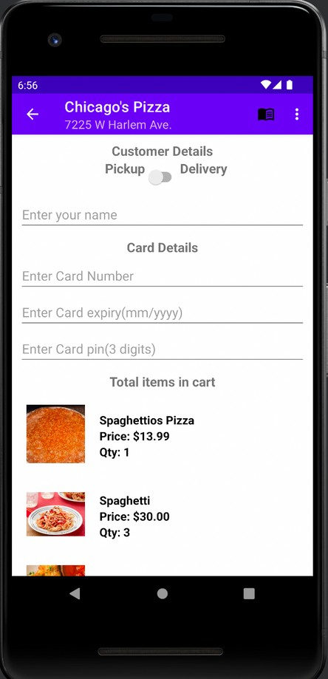
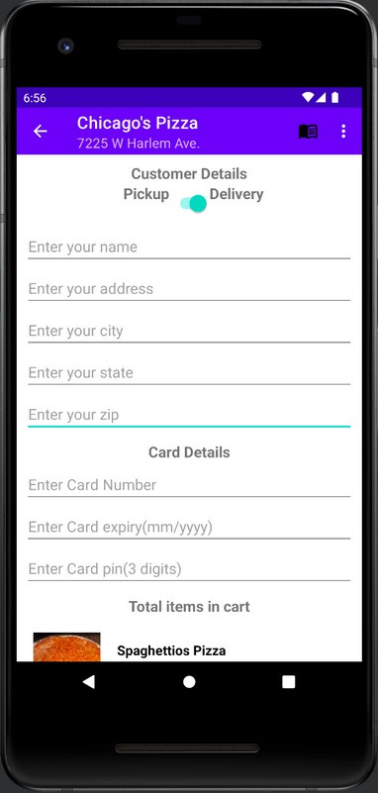
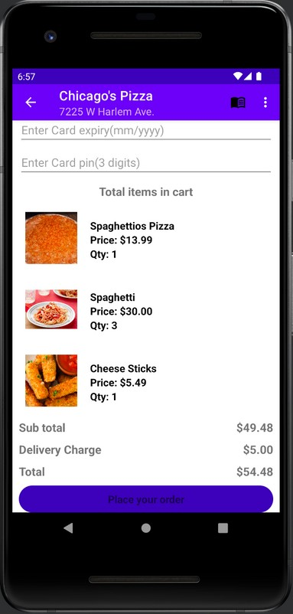
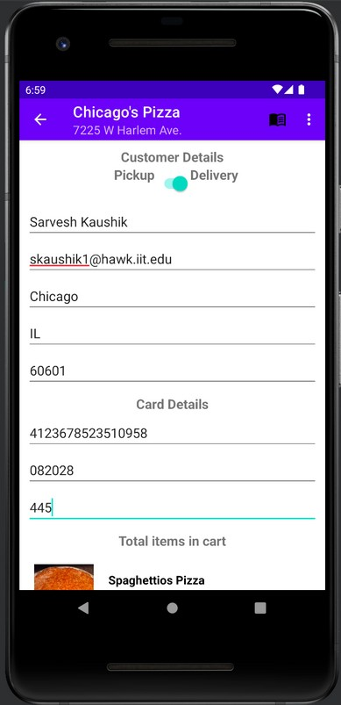



Application Flow
Users will have choice to pickup order or get home delivery.

Slide 11
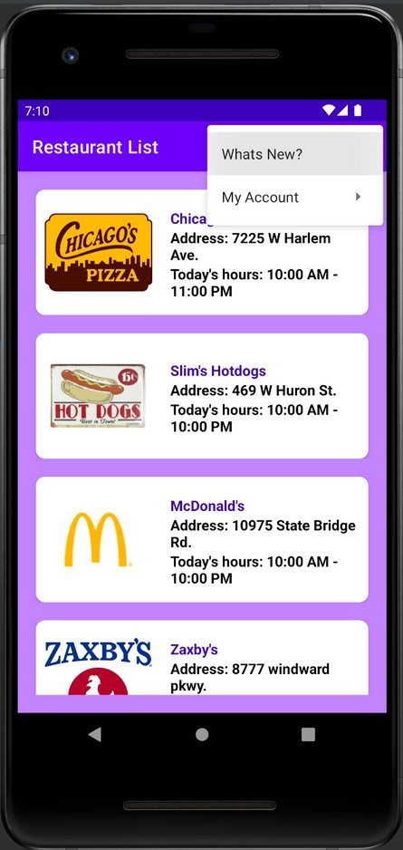
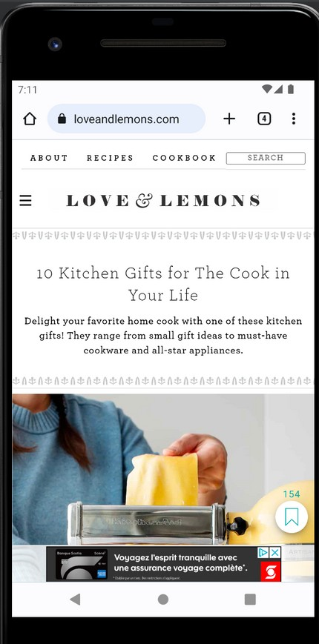
Application Flow
Users will be informed about new ongoing trends

Slide 12

Problems Encountered during your project
Implementing Gmail Sign up
Setting-up real time database
GitHub Code Base Synchronization Error

Slide 13
Future App Modifications
Google maps feature to track live location of delivery.
Suggestions on top restaurants based on their rating.
More information about the user in the my profile section.
Order history section to know previously ordered dishes.
Use of ML model to reduce the resource cost.

Slide 14
Q/A

